Slide 1

Gesture Controlled Virtual Mouse With Support Of Voice Assistant Prithvi J (1BM19CS122) S Shree Lakshmi(1BM19CS136) Sohan R Kumar(1BM19CS159) Suraj Nair(1BM19CS164)
SUNAYANA S
(Assistant Professor, BMSCE)
Department of Computer Science and Engineering
B.M.S. College of Engineering

Slide 2
OUTLINE:
Problem Statement
High level Design
Detailed Design
Implementation
Results/Snapshots of the output
Conclusion and Future Enhancements
Paper published
References

Slide 3
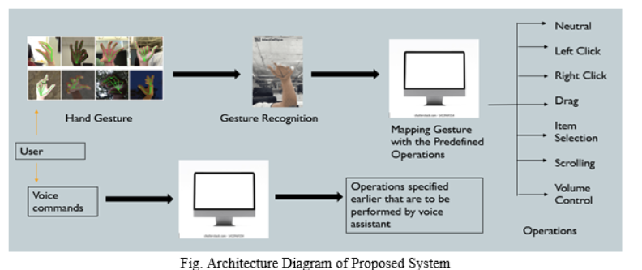
Problem Statement :
The problem statement is to develop a gesture-controlled virtual mouse technology that is supported by a voice assistant feature, providing a more accessible and user-friendly interface for all computer users, including those with motor disabilities.

Slide 4
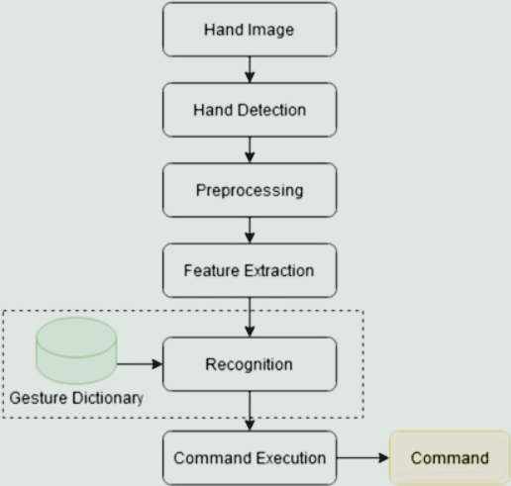
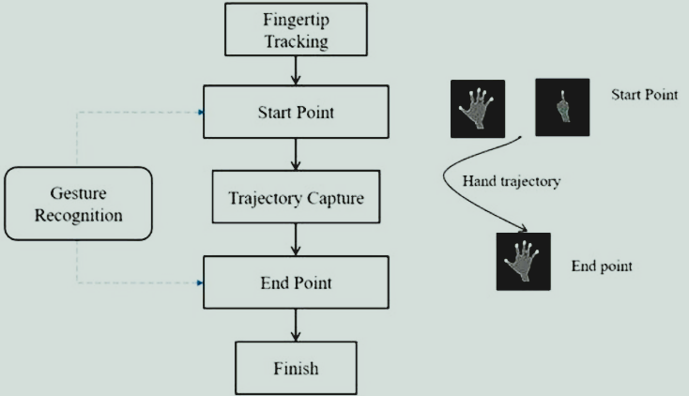
High level Design Of Gesture-Controlled Mouse:

Slide 5
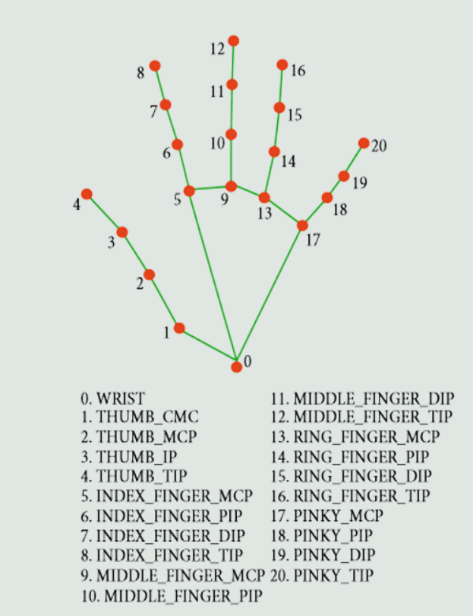
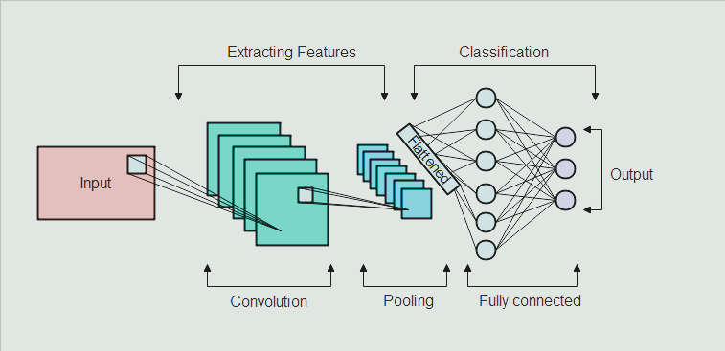
High Level Design Of Gesture-Controlled Mouse:
Hand Key Points
Classification Model-CNN

Slide 6
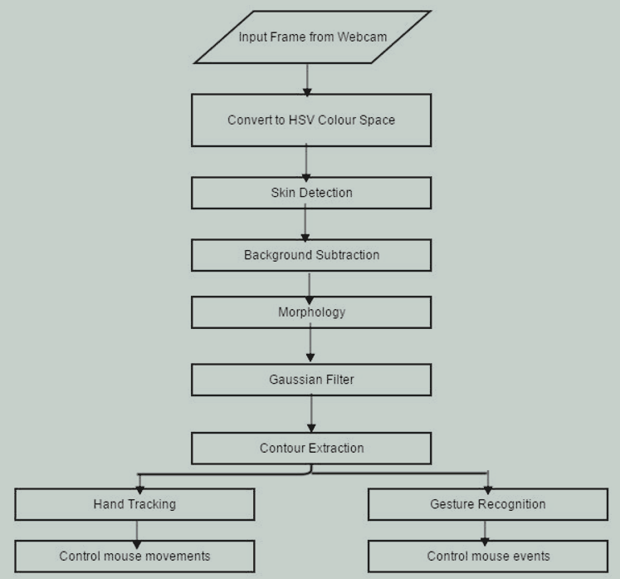
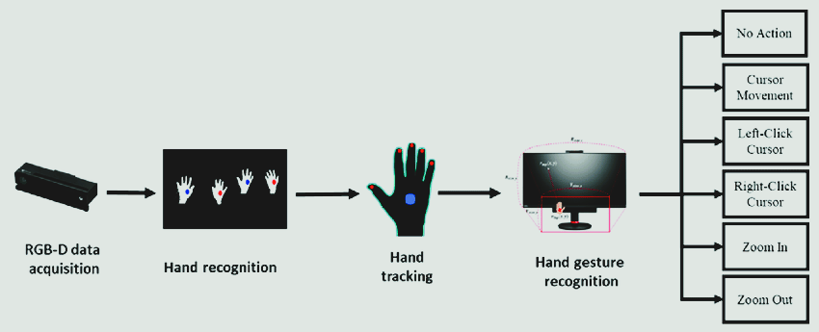
High Level Design Of Colour Cap-Controlled Mouse:
Flow Chart

Slide 7
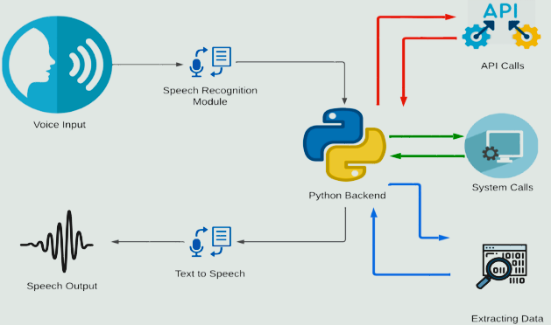
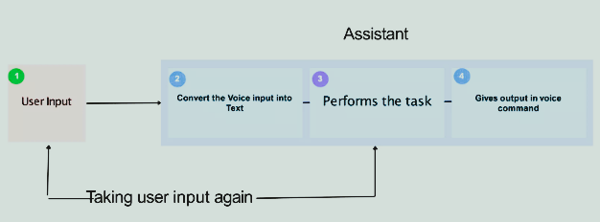
High Level Design Of Voice Assistant(ECHO):

Slide 8
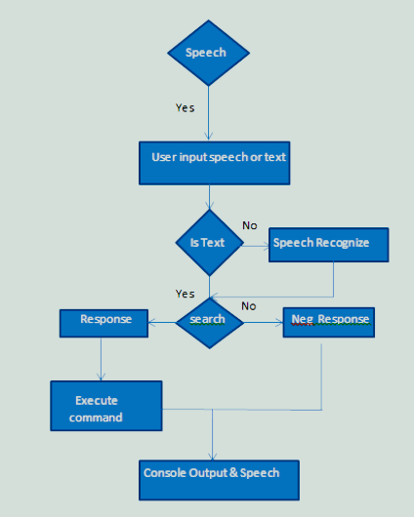
High Level Design Of Voice Assistant(ECHO):
Flow Chart

Slide 9
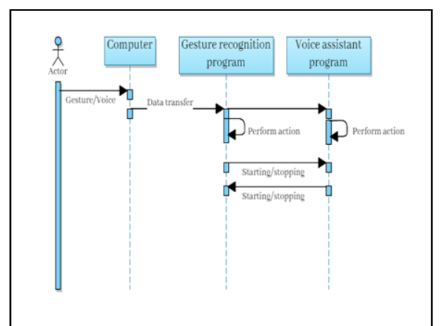
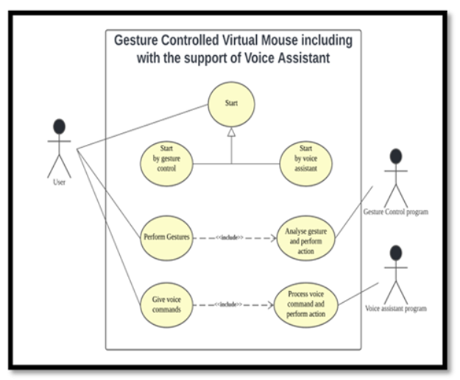
Detailed Design Of Gesture-Controlled Mouse And Voice Assistant(ECHO):
Sequence Diagram
Use-case Diagram

Slide 10
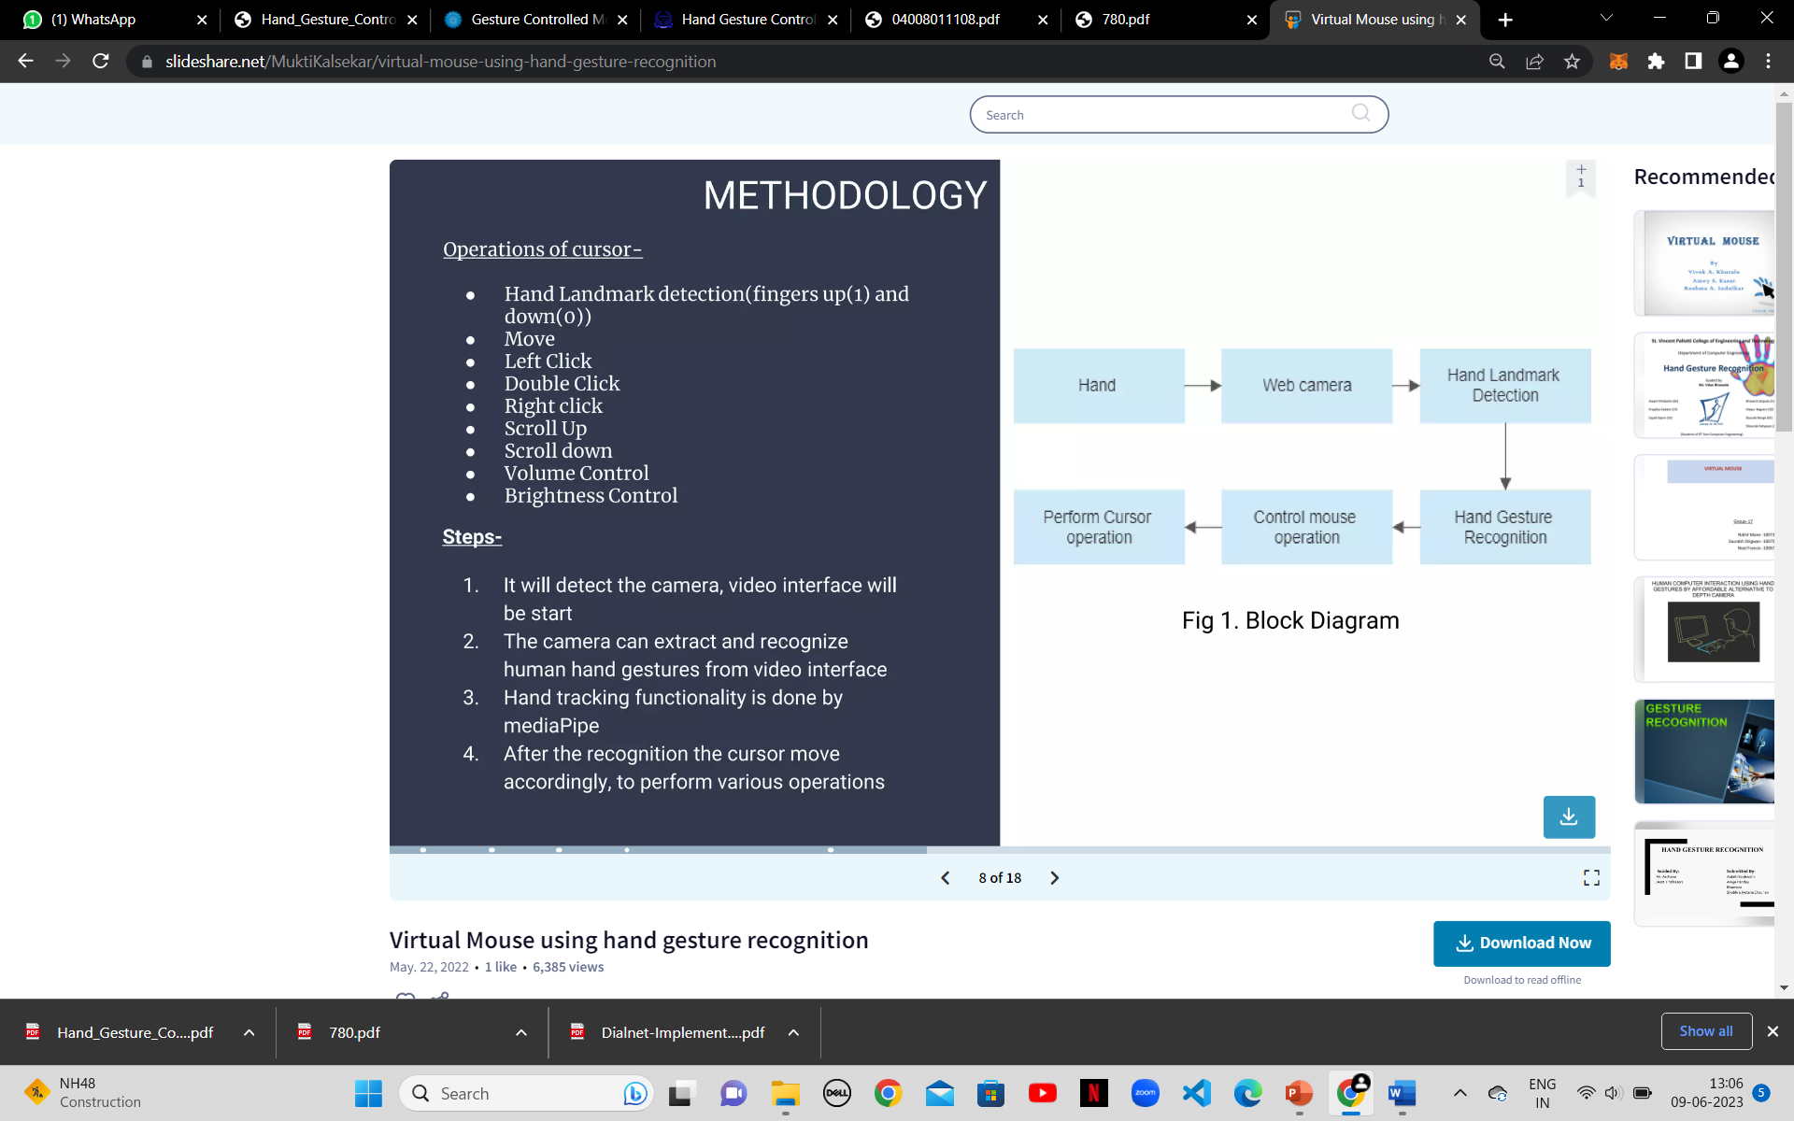
Methodology For Hand-Gesture Controlled Virtual Mouse:

Slide 11
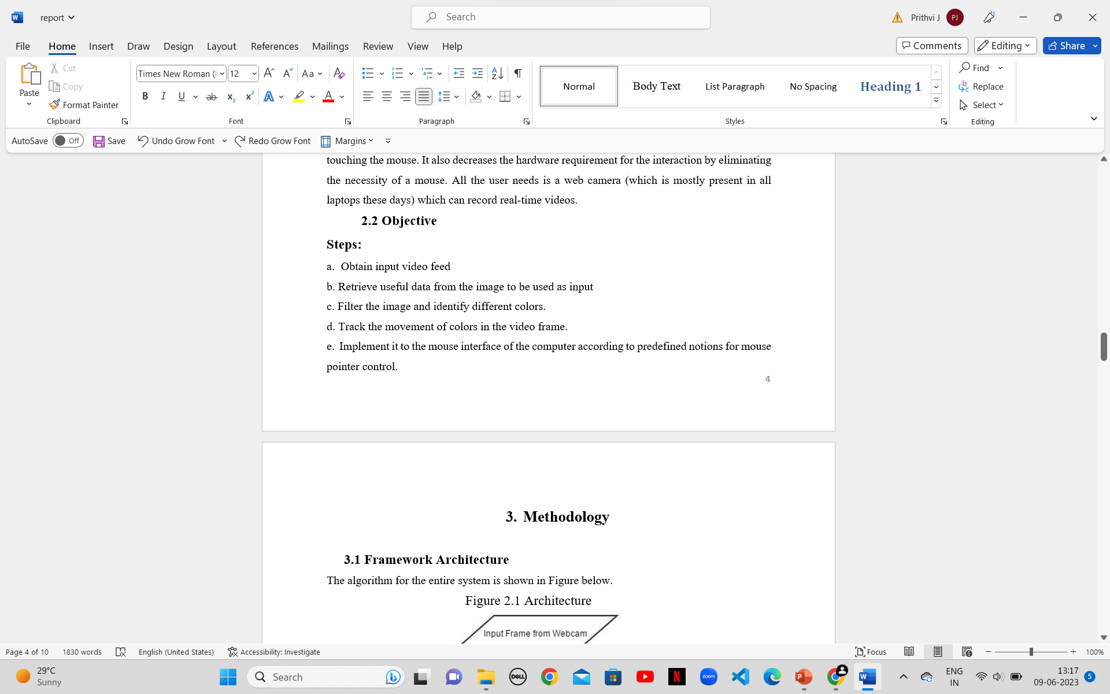
Methodology For Colored-Caps Controlled Virtual Mouse:

Slide 12
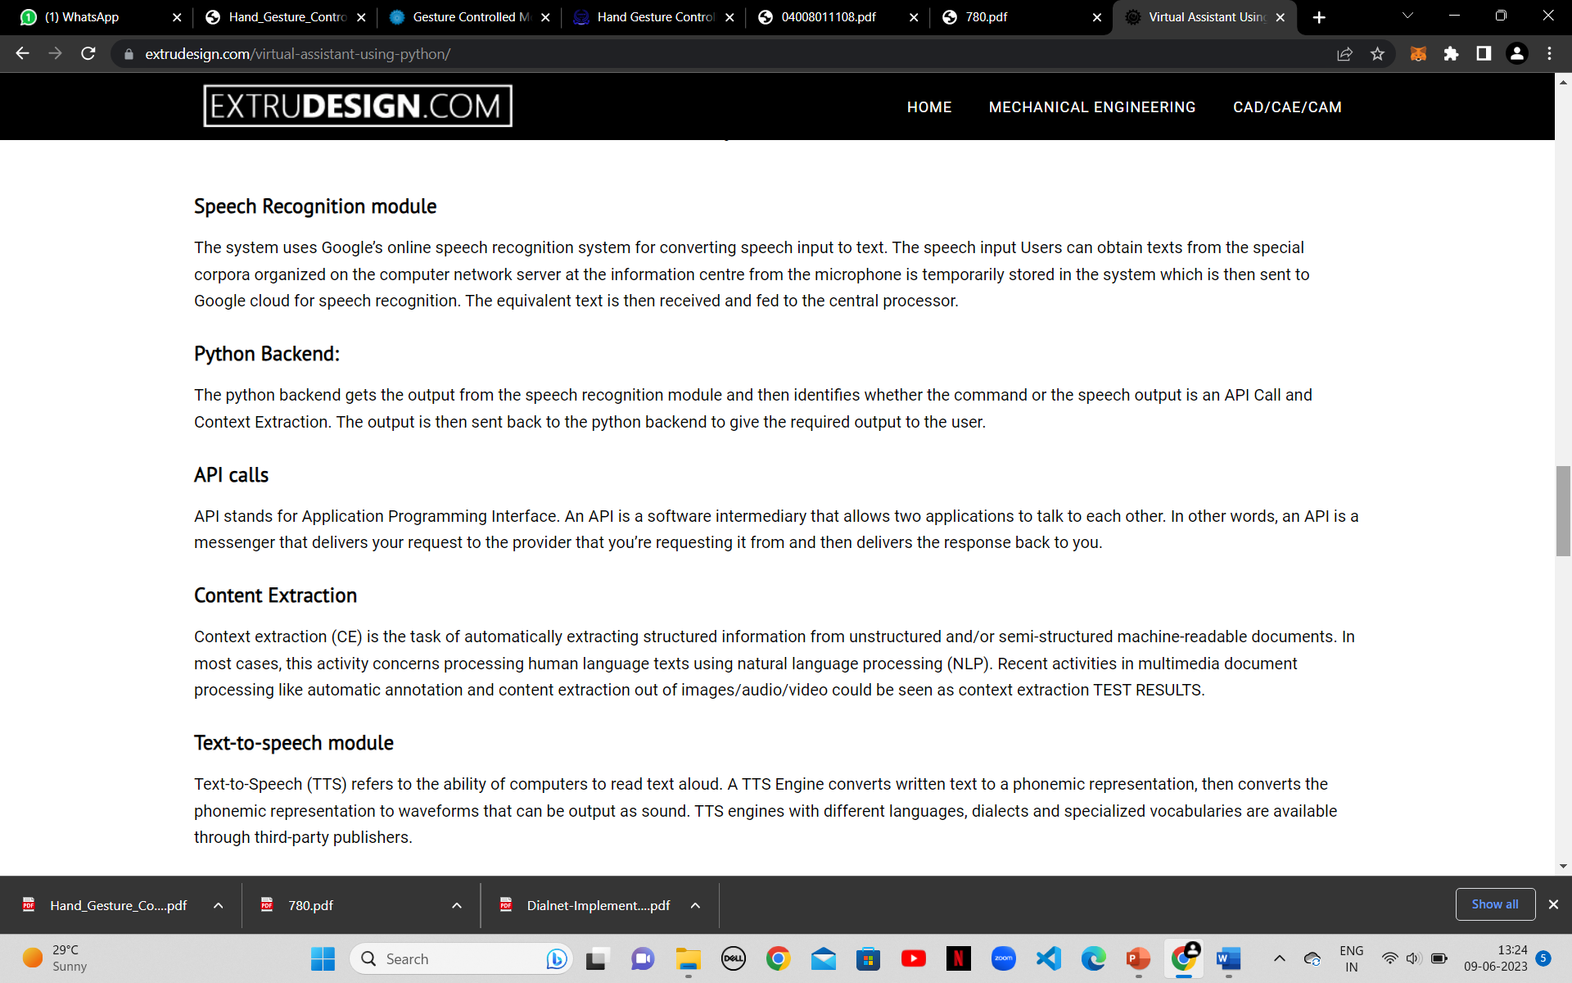
Methodology For Voice Assistant ECHO:

Slide 13
Implementation:
the Gesture Controlled Virtual Mouse system is an innovative and user-friendly solution that simplifies human-computer interaction. With its advanced machine learning and computer vision algorithms, it offers a reli- able and efficient way for users to control their computers using hand gestures, voice commands, or a combination of both.
Convolutional Neural Networks (MediaPipe running on top of pybind11)
The convolutional neural network (CNN) implemented by MediaPipe is based on deep learning algorithms that use a series of convolutional layers to extract features from images. The basic algorithm for CNNs can be summarized as follows:
Input layer: Accepts the input image and performs preprocessing such as normalization.
Convolution layer: Applies convolution operation to the input image using multiple filters to extract relevant features. The output of this layer is called a feature map.
Activation function: Introduces non-linearity to the feature maps.
Pooling layer: Reduces the spatial dimensions of the feature maps to reduce computational complexity.
Repeat steps 2-4 for multiple layers.
Flatten layer: Converts the feature maps into a vector to feed them into the fully connected layer.
Fully connected layer: Performs the classification task by applying weights and biases to the input vector.
Output layer: Produces the final output.

Slide 14
Gesture-Controlled Mouse Features Implemented:
Neutral Gesture: Neutral Gesture. Used to halt/stop execution of current gesture.
Move Cursor: Cursor is assigned to the midpoint of index and middle fingertips. This gesture moves the cursor to the
desired location. Speed of the cursor movement is proportional to the speed of hand.
Left Click: Gesture for single left click.
Right Click: Gesture for single right click.
Double Click: Gesture for double click.
Scrolling: Dynamic Gestures for horizontal and ver- tical scroll. The speed of scroll is proportional to the distance moved by pinch gesture from start point. Ver- tical and Horizontal scrolls are controlled by vertical and horizontal pinch movements respectively.
Drag and Drop: Gesture for drag and drop functionality. Can be used to move/tranfer files from one directory to
other.
Multiple Item Selection: Gesture to select multiple items.
Volume Control: Dynamic Gestures for Volume control. The rate of increase/decrease of volume is proportional to
the distance moved by pinch gesture from start point.
Brightness Control: Dynamic Gestures for Brightness control. The rate of increase/decrease of brightness is
proportional to the distance moved by pinch gesture from start point.

Slide 15
Colored Caps-Controlled Mouse Features Implemented:
Neutral Gesture: Neutral Gesture. Used to halt/stop execution of current gesture.
Move Cursor: Cursor is assigned to the midpoint of index and middle fingertips. This gesture moves the cursor to the
desired location. Speed of the cursor movement is proportional to the speed of hand.
Left Click: Gesture for single left click.
Right Click: Gesture for single right click.
Double Click: Gesture for double click.
Scrolling: Dynamic Gestures for horizontal and ver- tical scroll. The speed of scroll is proportional to the distance moved by pinch gesture from start point. Ver- tical and Horizontal scrolls are controlled by vertical and horizontal pinch movements respectively.
Drag and Drop: Gesture for drag and drop functionality. Can be used to move/tranfer files from one directory to
other.

Slide 16
Voice Assistant-(ECHO)Features Implemented:
Launch / Stop Gesture Recognition: Echo Launch Gesture Recognition Turns on webcam for hand gesture recognition. Echo Stop Gesture Recognition Turns off webcam and stops gesture recognition. (Termi- nation of Gesture controller can also be done via pressing Enter key in webcam window).
Google Search: Echo search (text you wish to search) : Opens a new tab on Chrome Browser if it is running, else opens a new window. Searches the given text on Google.
Find a Location on Google Maps: Echo Find a Location Will ask the user for the location to be searched.
(Location you wish to find) Will find the required location on Google Maps in a new Chrome tab.
File Navigation: Echo list files / Echo list Will list the files and respective file numbers in your Current Directory (by default C:)
Echo open (file number) Opens the file / directory corresponding to specified file number.
Echo go back /Echo back Changes the Current Directory to Parent Directory and lists the files.
Current Date and Time: Echo what is today’s date / Echo date Echo what is the time / Echo time Returns the current date and time.
Copy and Paste: Echo Copy Copies the selected text to clipboard. Echo Paste Pastes the copied text.
Sleep / Wake up Echo: Sleep Echo bye Pauses voice command execution till the assistant is woken up. Wake up Echo wake up Resumes voice command execution.
Exit: Echo Exit Terminates the voice assistant thread. GUI window needs to be closed manually.

Slide 17
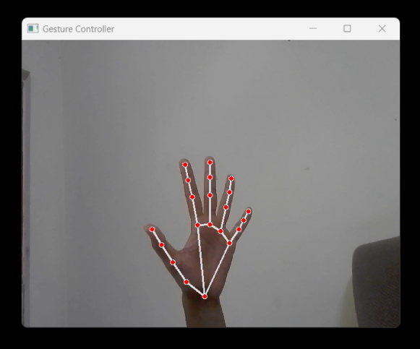
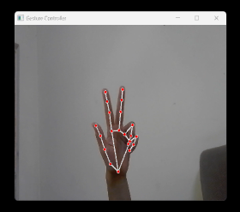
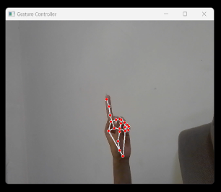
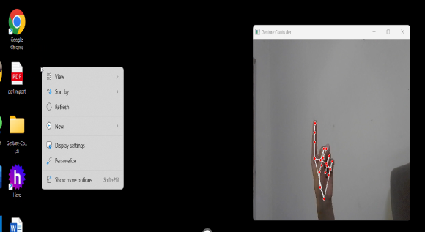
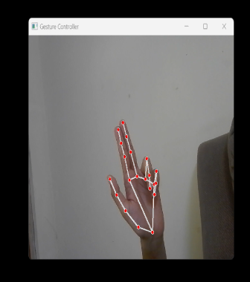
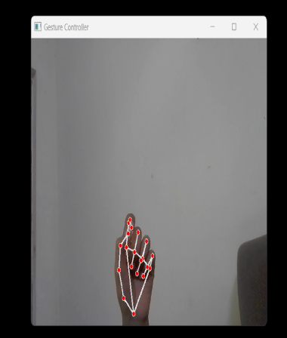
Gesture-Controlled Mouse Snapshots Of The Output :
Neutral Gesture:
Move Cursor:
Left Click:
Right Click:
Double Click:
Scrolling:

Slide 18
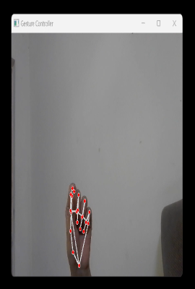
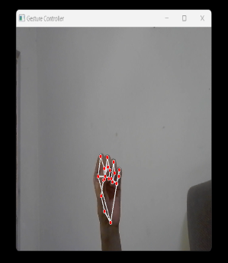
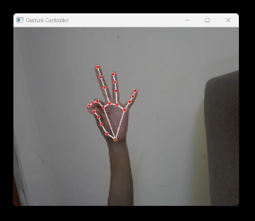
Gesture-Controlled Mouse Snapshots Of The Output :
Drag & Drop:
Multiple Item Selection:
Volume Control:
Brightness Control:

Slide 19
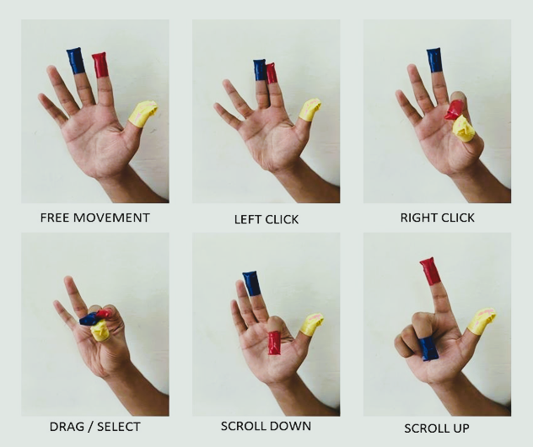
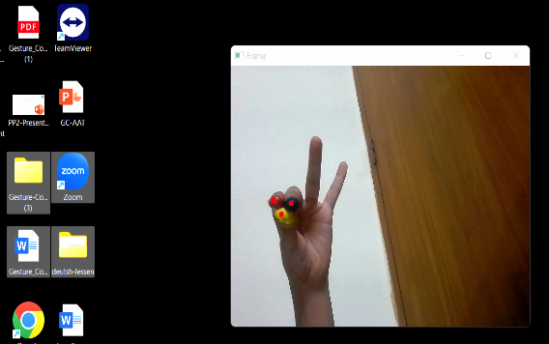
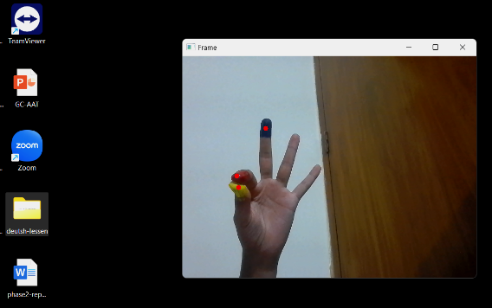
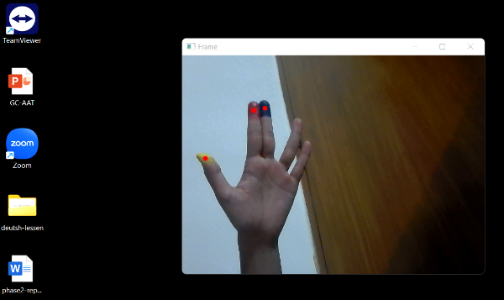
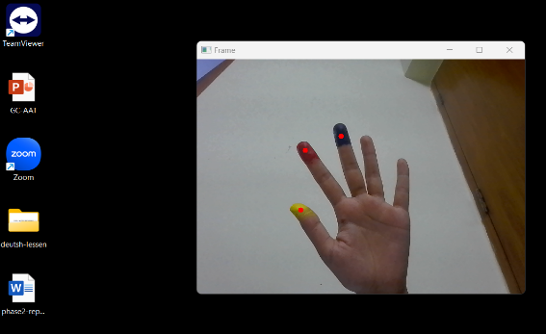
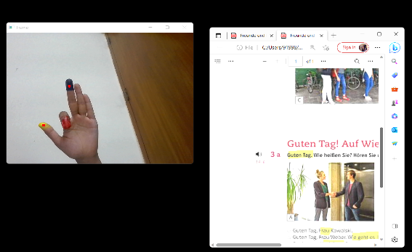
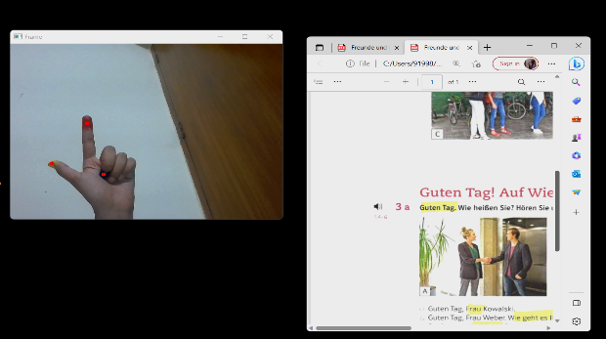
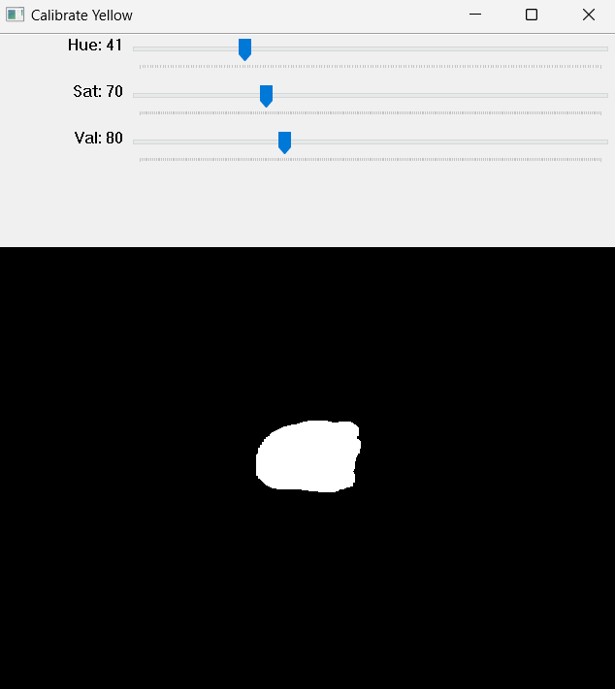
Colored Caps-Controlled Mouse Snapshots Of The Output :
Gestures:
Drag/Select:
Right Click:
Left Click:
Free Movement:
Scroll Down:
Scroll Up:
Color Calibration:

Slide 20
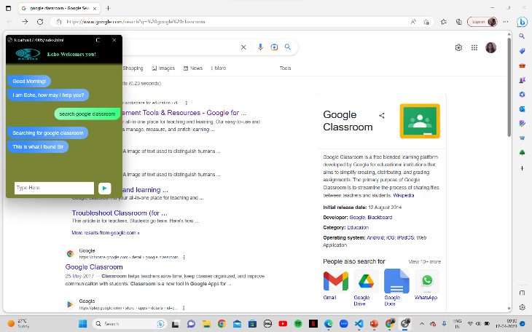
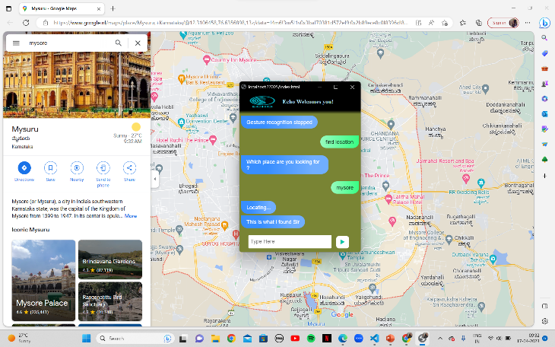
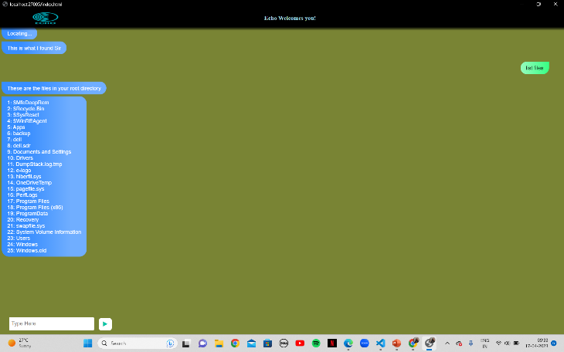
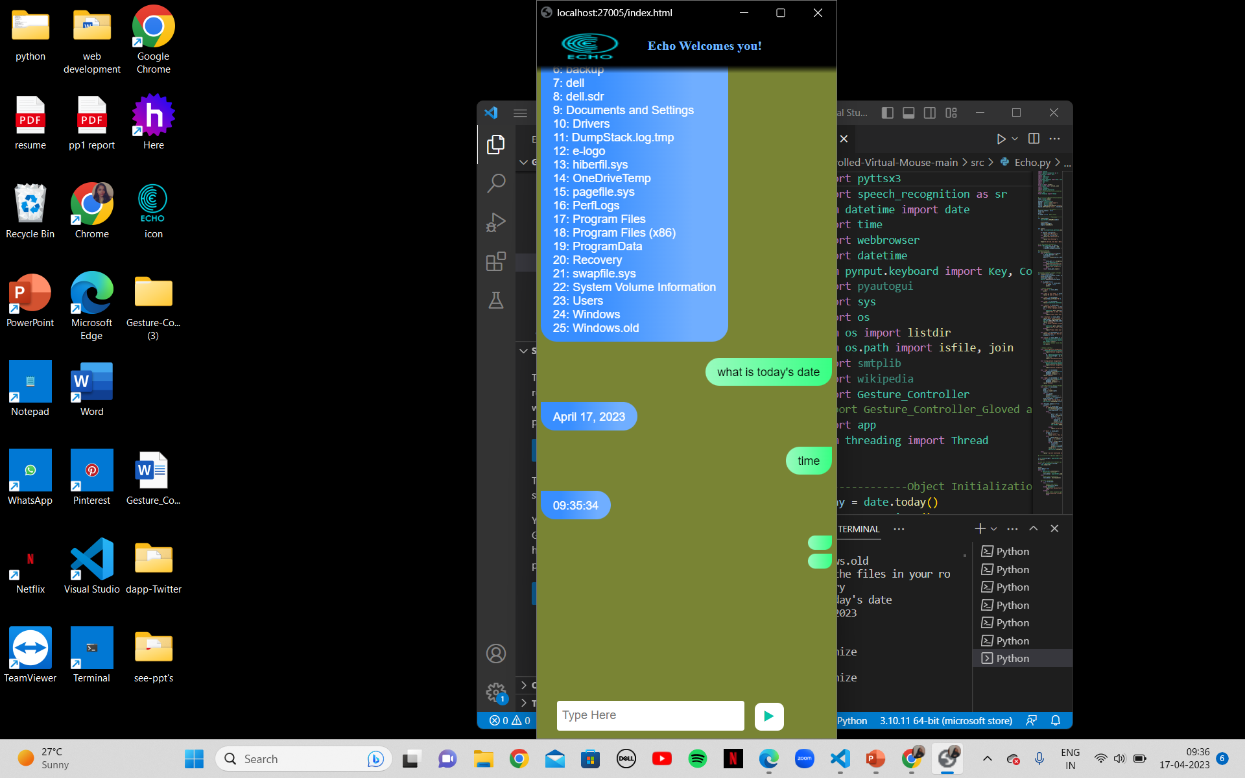
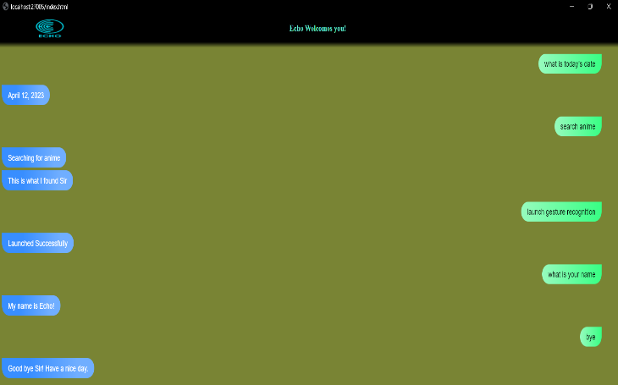
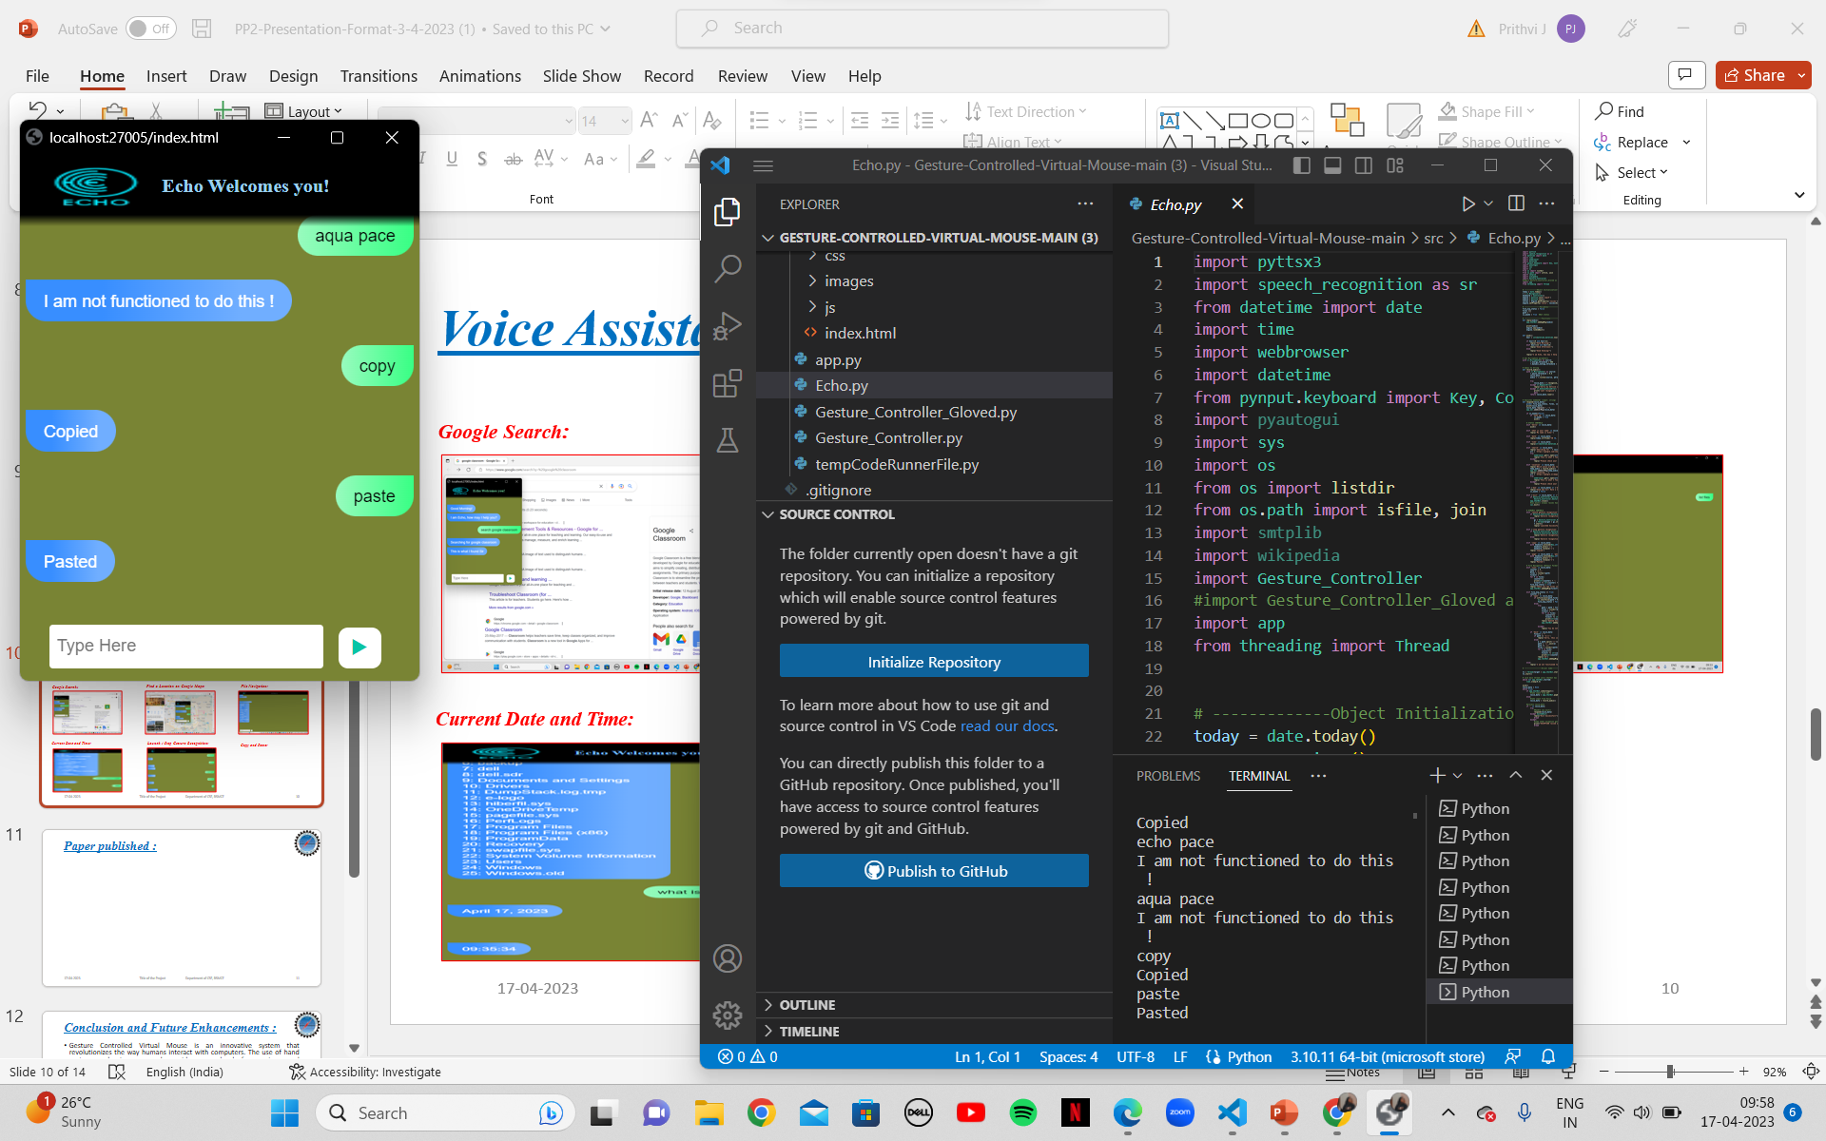
Voice Assistant-(ECHO)Snapshots Of The Output :
Google Search:
Find a Location on Google Maps:
File Navigation:
Current Date and Time:
Launch / Stop Gesture Recognition:
Copy and Paste:

Slide 21
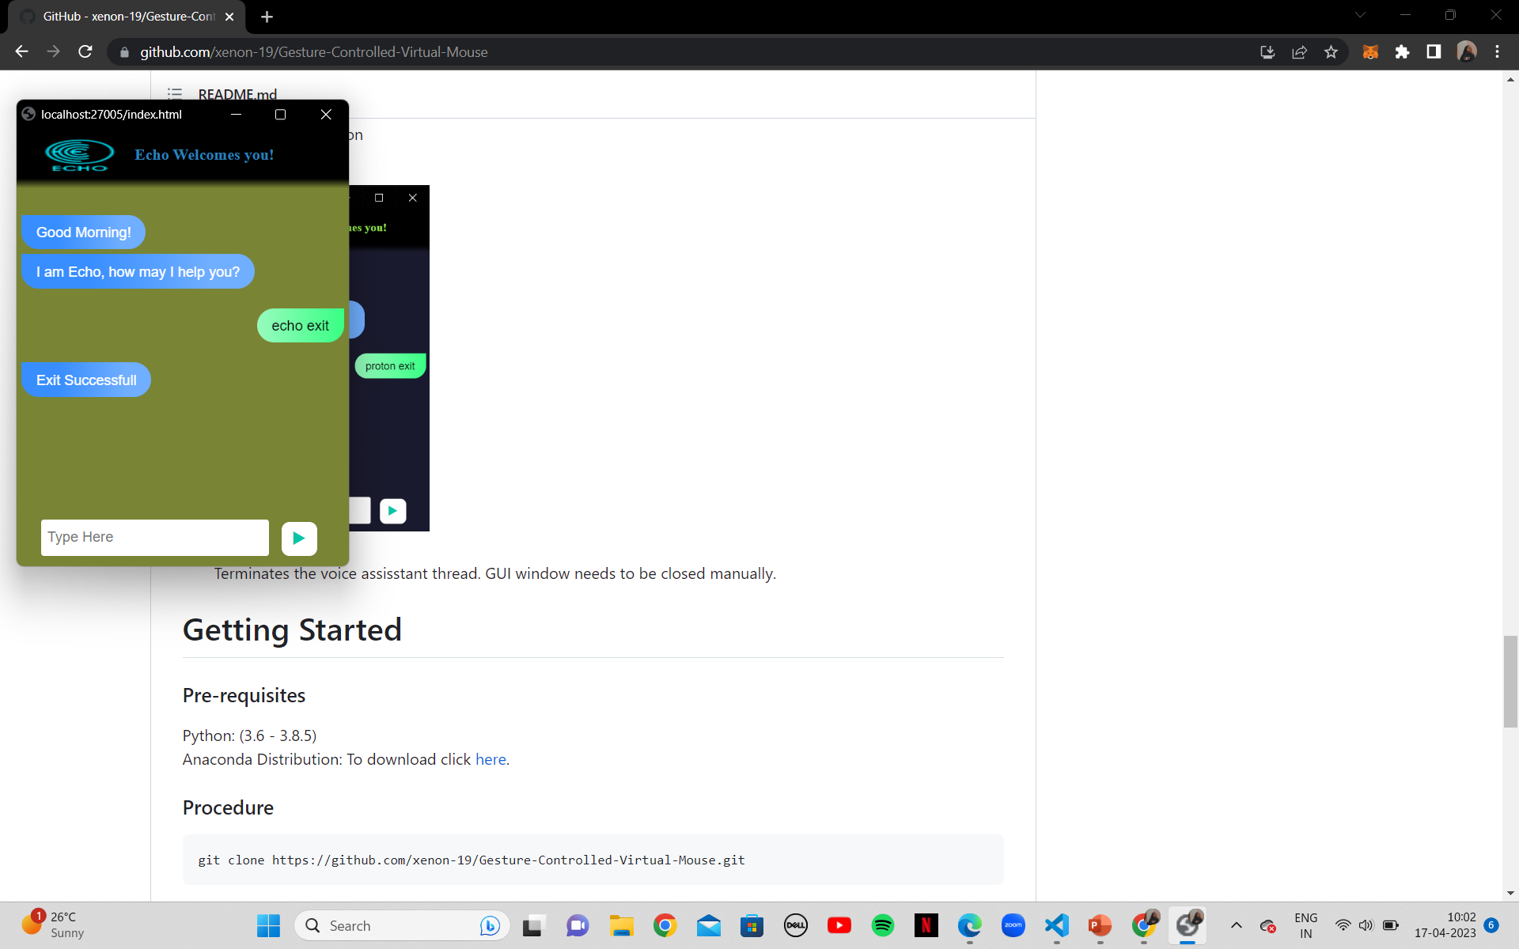
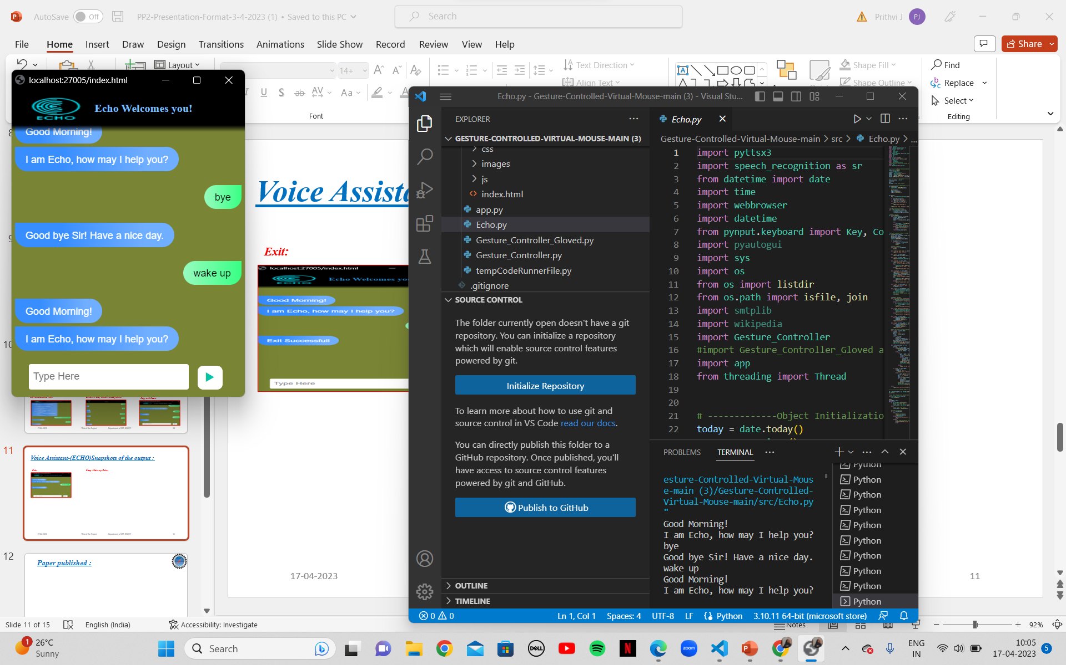
Voice Assistant-(ECHO)Snapshots Of The Output :
Exit:
Sleep / Wake up Echo:

Slide 22
Testing & Results:
The hand gesture and colored caps controlled virtual mouse along with voice recognition system incorporate various gestures like: neutral gesture, moving cursor, left click, right-click, double click, scrolling, drag and drop, multiple item selection.
The webcam is positioned at various distances from the user to monitor hand motions and gestures to detect fingertips.
Gesture’s ability is assessed under diverse lighting conditions such as bright light settings, low-light configurations, at a much farther distance from the camera, at a closer distance from the camera, with a left hand, right hand, both hands in camera, different backgrounds, and different hands of individuals of varying ages.
The voice assistant performs launch/stop gesture recognition, and content search on Google, identifies a location, navigates files, displays the current date and time, copies and pastes, sleeps/wakes up, and exit actions.
The Voice Assistant is tested by providing diverse input via the mic and executing various functions such as location, file navigation, current time and date, copy and paste, sleep/wakeup, google search, and start and exit under various conditions.

Slide 23
Testing & Results:
Using hand gestures to control a mouse can increase productivity and ease of use, particularly for individuals with disabilities or those who find traditional mouse controls difficult.
The automated training machine learning model accurately detects and classifies hand gestures, allowing for smooth and precise cursor control. While further research and testing may be necessary to optimize the system's performance.
The results thus far suggest that a hand gesture-controlled mouse could become a valuable tool for computer users in the future.

Slide 24
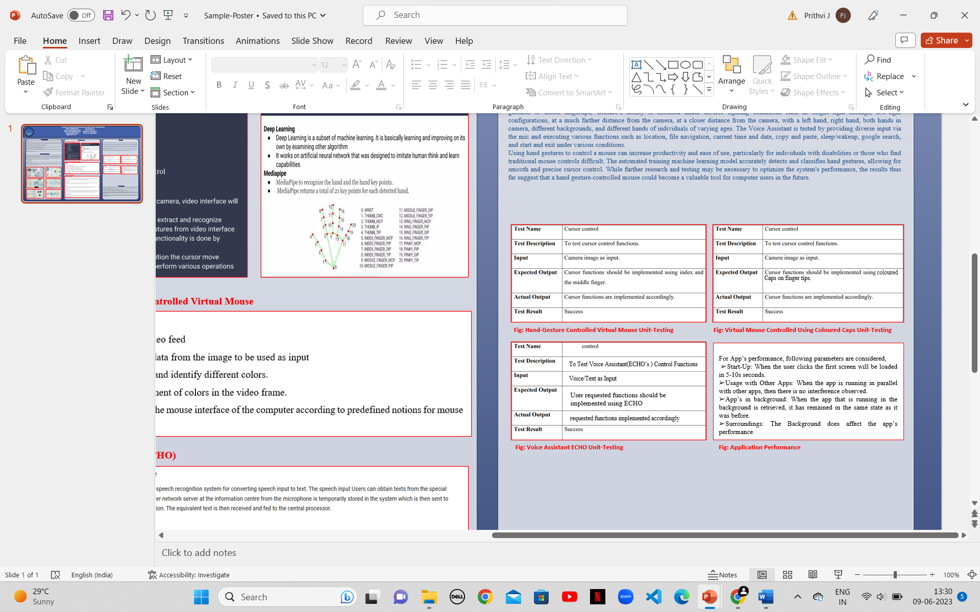
Testing & Results:

Slide 25
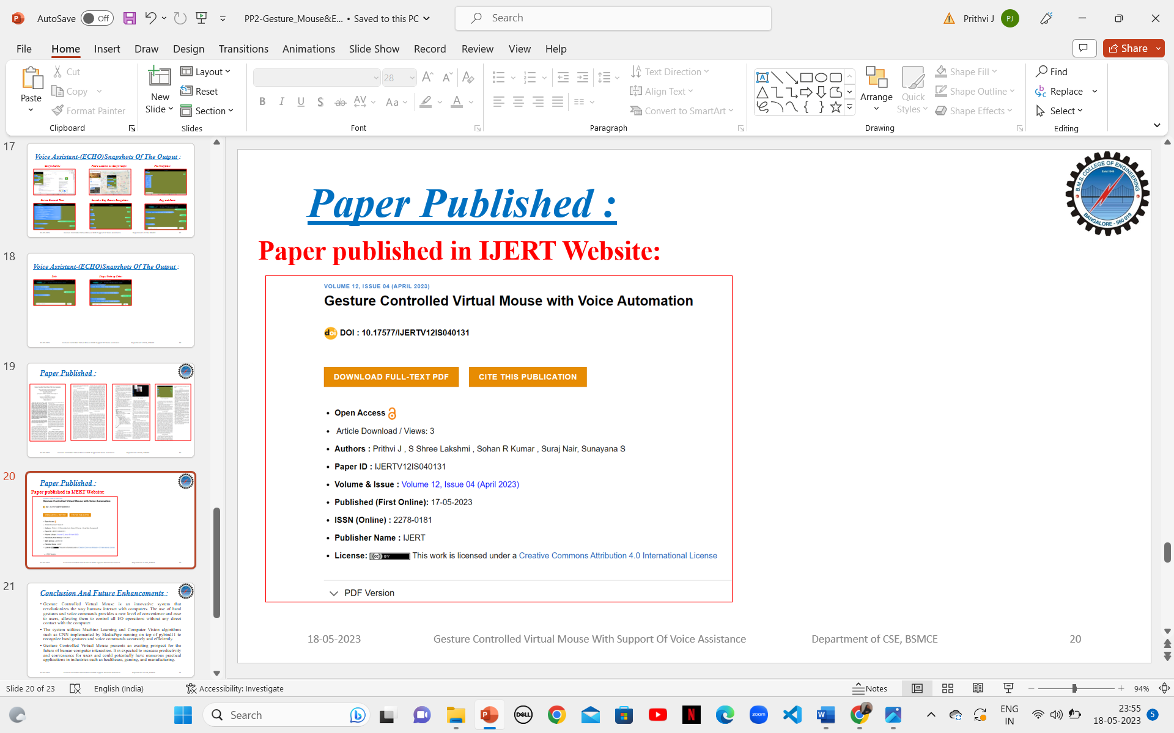
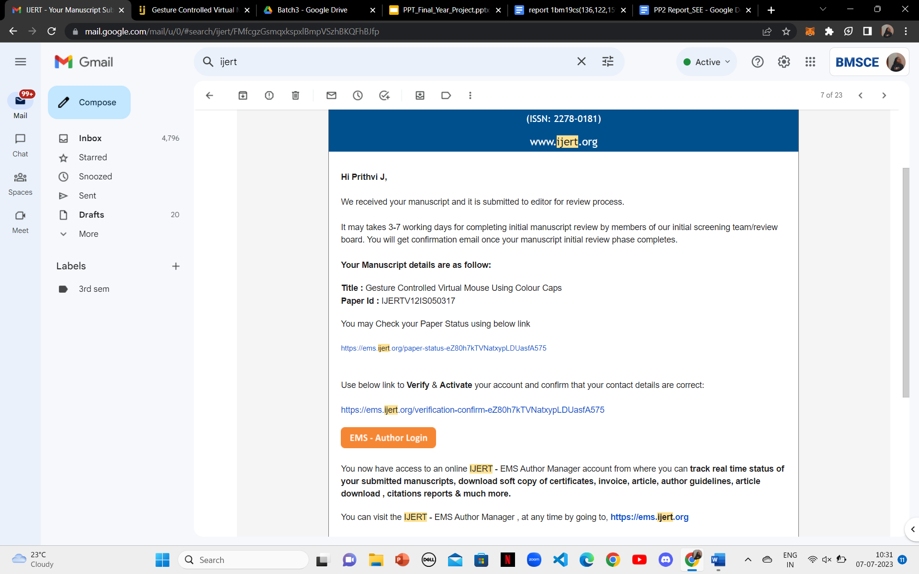
Paper Published :
Paper published in IJERT Website:

Slide 26
Conclusion and Future Enhancements :
The system utilizes state-of-the-art Machine Learning and Computer Vision algorithms such as CNN implemented by MediaPipe running on top of pybind11 to recognize hand gestures and voice commands accurately and efficiently.
The two modules - one for direct hand detection and the other for colored caps of any uniform color to carter different user preferences and provide flexibility in usage. Additionally, the system incorporates a voice automation feature that serves various tasks with great efficiency, accuracy, and ease. With the current implementation of the system on the Windows platform.
Gesture Controlled Virtual Mouse presents an exciting prospect for the future of human-computer interaction. It is expected to increase productivity and convenience for users and could potentially have numerous practical applications in industries such as healthcare, gaming, and manufacturing.
The system has the potential of being a viable replacement for the computer mouse, however due to the constraints encountered; it cannot completely replace the computer mouse. The major constraint of the system is that it must be operated in a well-lit room. This is the main reason why the system cannot completely replace the computer mouse, since it is very common for computers to be used in outdoor environments with poor lighting condition.

Slide 27
Potential Applications, Focus Groups & Target Audience
Medical Industry: -
1.Upper limb disabilities: Individuals with conditions such as muscular dystrophy, spinal cord injuries, or cerebral palsy may have limited or no use of their hands. Using hand gestures for a virtual mouse can provide an alternative method of control.
2. Carpal tunnel syndrome: People with carpal tunnel syndrome experience pain, numbness, and weakness in the hand due to compression of the median nerve. Operating a physical mouse may exacerbate their symptoms, whereas hand gestures may be less strenuous.
3. Parkinson's disease: Parkinson's disease can cause tremors, stiffness, and difficulty with fine motor control. Using hand gestures for a virtual mouse can offer a more forgiving input method for individuals with these symptoms.
4. Arthritis: Arthritis affects joint flexibility and can make manipulating a physical mouse uncomfortable or challenging. Hand gestures can provide a more accessible option for people with arthritis.
5. Amputations or limb loss: Individuals who have lost a hand or an arm may find it challenging to use a traditional mouse. Hand gesture control for a virtual mouse can compensate for the missing limb and provide an alternative means of interaction.
6. Temporary injuries: People recovering from hand or arm injuries, such as fractures or surgeries, may find it easier to use hand gestures for a virtual mouse during their rehabilitation period.
7. Visual impairments: Individuals with visual impairments may find it challenging to locate and accurately control a physical mouse. Virtual mouse control through hand gestures can provide a more intuitive and accessible interface.

Slide 28
Potential Applications, Focus Groups & Target Audience
8. Repetitive strain injuries (RSI): RSI is a condition caused by repetitive motions or overuse of certain muscles. Operating a physical mouse can aggravate RSI symptoms, whereas hand gesture control can offer a less taxing alternative.
9. Multiple sclerosis (MS): MS can lead to difficulties with motor control, including hand tremors, muscle weakness, and coordination issues. Using hand gestures for a virtual mouse can help compensate for these challenges.
10. Spinal cord injuries: Depending on the level and extent of a spinal cord injury, individuals may have limited or no control over their hands or fingers. Hand gesture-based virtual mouse control can enable them to navigate and interact with computers or devices.
11. Amyotrophic lateral sclerosis (ALS): ALS is a progressive neurodegenerative disease that affects muscle control and movement. As the condition advances, individuals may lose the ability to use a physical mouse, making hand gesture control a more viable option.
12. Stroke: Stroke survivors may experience motor impairments, including weakness or paralysis on one side of the body. Hand gesture-based virtual mouse control can facilitate computer usage and aid in rehabilitation.
13. Essential tremor: Essential tremor is a neurological disorder characterized by involuntary shaking movements, primarily affecting the hands. Using hand gestures for a virtual mouse can help mitigate the impact of tremors on precise mouse control.
14. Severe pain or discomfort: Conditions that cause significant pain or discomfort in the hands or arms, such as fibromyalgia or complex regional pain syndrome (CRPS), may make using a physical mouse challenging. Hand gesture control offers an alternative method that may be less painful.
15. Cognitive impairments: Some individuals with cognitive impairments or developmental disabilities may find it easier to understand and interact with a virtual mouse using hand gestures, as it can provide a more intuitive and simplified interface.

Slide 29
Potential Applications, Focus Groups & Target Audience
16. Osteoarthritis: Osteoarthritis is a degenerative joint disease that can affect the hands, causing pain, stiffness, and reduced range of motion. Hand gesture control for a virtual mouse can be a more comfortable and accessible option for individuals with this condition.
17. Peripheral neuropathy: Peripheral neuropathy is a condition that affects the peripheral nerves, leading to numbness, tingling, and weakness in the hands. Operating a physical mouse may be challenging, whereas hand gestures can provide an alternative means of navigation.
18. Dystonia: Dystonia is a neurological movement disorder characterized by involuntary muscle contractions, resulting in repetitive or twisting movements. Using hand gestures for a virtual mouse can help overcome the challenges posed by dystonic movements.
19. Tremors: Various conditions, such as essential tremor or tremors associated with medications, can cause uncontrollable shaking of the hands. Hand gesture-based virtual mouse control can allow individuals with tremors to interact with computers more effectively.
20. Complex regional pain syndrome (CRPS): CRPS is a chronic pain condition that typically affects the arms or legs. Using a physical mouse may exacerbate pain symptoms, while hand gesture control can provide a less intrusive option.
21. Hand or arm fractures: Individuals recovering from hand or arm fractures may have limited mobility or be unable to use a traditional mouse. Hand gesture-based virtual mouse control can help maintain productivity during the recovery period.
22. Neurological conditions: Various neurological conditions, such as Huntington's disease or ataxia, can impair motor function and coordination. Hand gesture control for a virtual mouse can offer a more accessible method of computer interaction.
23. Seniors with mobility issues: Older adults who experience age-related decline in motor skills or mobility may find hand gesture-based virtual mouse control more intuitive and easier to use than a physical mouse.

Slide 30
Potential Applications, Focus Groups & Target Audience
Other Scenarios (As a means of convenience, and improved performance and efficiency): -
Limited desk space: In situations where desk space is limited, using hand gestures as a virtual mouse eliminates the need for a physical mouse, allowing for a more streamlined and clutter-free workspace.
Mobility and portability: When using a laptop or portable computer in different locations, carrying a physical mouse may be inconvenient. Hand gesture-based virtual mouse control offers a portable and on-the-go alternative.
Touchpad or trackpad discomfort: Some individuals may find touchpads or trackpads uncomfortable to use for extended periods. Hand gesture-controlled virtual mouse interfaces provide an alternative method that can be more comfortable and ergonomic.
Presentations and meetings: When giving presentations or attending meetings, using hand gestures for a virtual mouse enables presenters or participants to control slides, interact with content, and navigate through documents without being tethered to a physical mouse or touchpad.
Accessibility considerations: Hand gesture-based virtual mouse control can be beneficial for individuals with motor disabilities, dexterity limitations, or conditions that make using a traditional mouse challenging. It provides a more accessible means of computer interaction.
Multi-monitor setups: For users with multi-monitor setups, hand gesture-controlled virtual mouse interfaces can offer more efficient navigation and control across multiple screens without the need to constantly move a physical mouse between monitors.
Gesture shortcuts and gestures-based commands: Hand gesture-controlled virtual mouse interfaces can support customized gesture shortcuts or commands, allowing users to perform actions or trigger functions quickly and efficiently.
Gesture-based scrolling and zooming: Hand gestures can be used to control scrolling and zooming actions, providing a more intuitive and natural way to navigate through documents, websites, or large datasets.

Slide 31
Potential Applications, Focus Groups & Target Audience
Collaborative work and brainstorming sessions: When working collaboratively on a shared screen or whiteboard, using hand gestures as a virtual mouse enables participants to interact with content, annotate, draw, and make changes in a more fluid and engaging manner.
Language input and translation: Hand gesture-controlled virtual mouse interfaces can be utilized for input methods that involve sign language or gestures-based communication. This can be particularly useful for individuals who primarily communicate through gestures or sign language.
Unconventional or non-flat surfaces: Hand gesture-controlled virtual mouse interfaces can work on non-flat or unconventional surfaces, such as uneven tabletops or surfaces with limited space, where using a physical mouse may be challenging or impractical.
Intuitive touchless interactions: Hand gesture-based virtual mouse control offers touchless interactions, which can be beneficial in scenarios where maintaining cleanliness and hygiene is crucial, such as in healthcare facilities, laboratories, or public environments.
Rapid switching between tasks: Using hand gestures for a virtual mouse allows for quick switching between tasks and applications without the need to physically locate and move a mouse or switch between windows using traditional methods. Drawing, sketching, and artistic applications: Hand gesture-controlled virtual mouse interfaces can be advantageous for artists, designers, or architects, as they offer more precise control over digital drawing tools, brushstrokes, and sketching applications.
Accessibility in public spaces: In public spaces such as libraries, educational institutions, or shared work environments, hand gesture-based virtual mouse control can offer a convenient and accessible option for individuals who do not have access to their own physical mouse.
Gesture-based gaming and entertainment: Hand gesture-controlled virtual mouse interfaces can enhance gaming experiences and entertainment applications by providing more immersive and intuitive control over virtual environments, characters, and interactive content.

Slide 32
Potential Applications, Focus Groups & Target Audience
Control for digital signage and kiosks: Hand gesture-based virtual mouse interfaces can be implemented in interactive kiosks or digital signage systems, enabling users to navigate through menus, access information, and interact with content using gestures.
Hands-on training and simulations: In training scenarios that involve simulations or virtual environments, hand gesture-controlled virtual mouse interfaces provide a more realistic and immersive way for users to interact with virtual objects, perform tasks, and receive feedback.
Remote collaboration and teleconferencing: Hand gesture-based virtual mouse control can enhance remote collaboration and teleconferencing by allowing participants to navigate shared screens, interact with content, and control applications using gestures, fostering a more engaging and interactive collaboration experience.
Experimental or research interfaces: Hand gesture-controlled virtual mouse interfaces are often used in experimental interfaces and research projects to explore novel methods of human-computer interaction, interface design, and gesture recognition algorithms.
Public or shared computers: In public settings like libraries, internet cafes, or shared workspaces, using hand gesture-controlled virtual mouse interfaces eliminates the need for physical mice, ensuring a more hygienic and convenient computing experience.
Language barriers: Hand gesture-controlled virtual mouse interfaces can transcend language barriers by providing a universal means of interaction. Users can navigate through applications, websites, or interfaces using intuitive hand gestures, irrespective of their spoken language.
Precision tasks and fine control: Hand gesture-controlled virtual mouse interfaces can offer precise control for tasks that require fine movements or intricate interactions, such as detailed graphic design work, precise cursor positioning, or intricate photo editing.
Remote desktop or virtual machine usage: When accessing remote desktops or virtual machines, using hand gesture-controlled virtual mouse interfaces can enhance the user experience by allowing seamless control over the remote environment, regardless of the physical hardware being used.

Slide 33
Potential Applications, Focus Groups & Target Audience
Ergonomic considerations: Hand gesture-controlled virtual mouse interfaces offer ergonomic benefits by reducing the strain on wrists, hands, and fingers associated with prolonged mouse usage. Users can perform gestures without the need to grip or manipulate a physical mouse.
Rapid access to frequently used functions: Gesture-based virtual mouse interfaces can be customized to provide quick access to frequently used functions or shortcuts. Users can perform specific gestures to trigger actions, saving time and enhancing workflow efficiency.
Multitasking and productivity: Hand gesture-controlled virtual mouse interfaces allow users to perform gestures for switching between applications, managing multiple windows, or accessing system functions, enhancing multitasking capabilities and overall productivity.
Accessibility for individuals with visual impairments: Hand gesture-controlled virtual mouse interfaces can be combined with auditory or haptic feedback to provide an accessible means of interaction for individuals with visual impairments, enabling them to navigate and interact with computers more effectively.
Augmented reality interfaces: In augmented reality (AR) applications, hand gesture-controlled virtual mouse interfaces can provide a natural and intuitive way to interact with virtual objects, manipulate virtual environments, and access AR-based features and functions.
Brain-computer interface integration: Hand gesture-controlled virtual mouse interfaces can be integrated with brain-computer interface technologies, allowing individuals with severe motor disabilities to control computers using their brain signals and hand gestures combined.

Slide 34
References:
Tsang, W.-W. M., & Kong-Pang Pun. (2005). A finger-tracking virtual mouse realized in an embedded system. 2005 International Symposium on Intelligent Signal Processing and Communication Systems. doi:10.1109/ispacs.2005.1595526.
Tsai, T.-H., Huang, C.-C., & Zhang, K.-L. (2015). Embedded virtual mouse system by using hand gesture recognition. 2015 IEEE International Conference on Consumer Electronics - Taiwan. doi:10.1109/icce-tw.2015.721693910.1109/icce-tw.2015.7216939.
Roh, M.-C., Huh, S.-J., & Lee, S.-W. (2009). A Virtual Mouse interface based on Two- layered Bayesian Network. 2009 Workshop on Applications of Computer Vision (WACV). doi:10.1109/wacv.2009.540308210.1109/wacv.2009.5403082.
Li Wensheng, Deng Chunjian, & Lv Yi. (2010). Implementation of virtual mouse based on machine vision. 2010 International Conference on Apperceiving Computing and Intelligence Analysis Proceeding. doi:10.1109/icacia.2010.5709921 10.1109/icacia.2010.5709921.
Choi, O., Son, Y.-J., Lim, H., & Ahn, S. C. (2018). Co-recognition of multiple fingertips for tabletop human-projector interaction. IEEE Transactions on Multimedia, 1– 1. doi:10.1109/tmm.2018.2880608.
Jyothilakshmi P, Rekha, K. R., & Nataraj, K. R. (2015). A framework for human-machine interaction using Depthmap and compactness. 2015 International Conference on Emerging Research in Electronics, Computer Science Technology (ICERECT). doi:10.1109/erect.2015.7499060.

Slide 35
Thank You

